Slide 1
Leeds Beckett University
Cloud Computing Development
Dr Anatoliy Gorbenko
E-mail: A.Gorbenko@leedsbeckett.ac.uk Office: CAE118
Kiran Voderhobli
E-mail: k.voderhobli@leedsbeckett.ac.uk Office: CAE228

Slide 2
Cloud Computing Development
Lecture: BigData storage and processing: NoSQL and Hadoop
Anatoliy Gorbenko
Kiran Voderhobli

Slide 3

Lecture Agenda
ACID vs BASE
NoSQL Databases
MapReduce
Hadoop

Slide 4
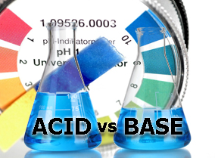
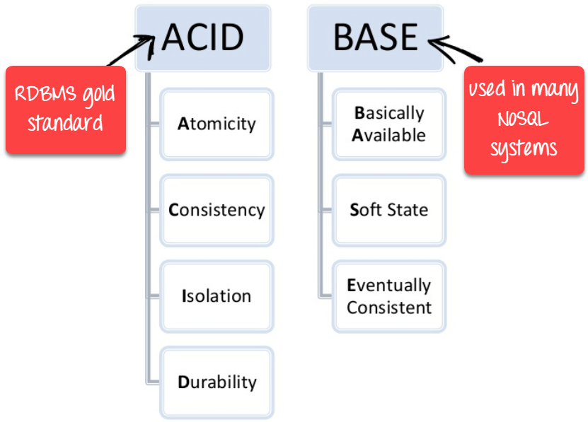

Slide 5

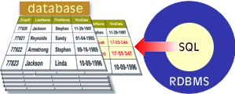
ACID + RDBMS + SQL
ACID is a set of properties that guarantee that database transactions are processed reliably:
Atomicity;
Consistency;
Isolation;
Durability.
ACID properties are traditionally supported by RDBMS (e.g. MySQL)
RDBMS support SQL

Slide 6
BASE Properties
BASE as opposed to ACID
Basically Available – possibilities of failures but not a failure of the whole system
Soft state – copies of a data item may be inconsistent
Eventually Consistent – copies becomes consistent at some later time if there are no more updates to that data item

Slide 7



Slide 8
NoSQL Databases
The name stands for Not Only SQL
2009, Eric Evans (Rackspace)
Common features:
non-relational
do not require a fixed table schema
horizontal scalable
very fast data access (reads and writes)
mostly open source

Slide 9
NoSQL Databases
More characteristics
the data structure (e.g. key-value, graph, or document) differs from the RDBMS
relax one or more of the ACID properties
choose A-P or C-P (see CAP theorem)
replication support
easy API (very restricted variant of SQL)
Do not fully support relational features
no join operations (except within partitions),
no referential integrity constraints across partitions.

Slide 10

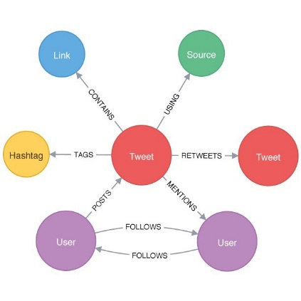
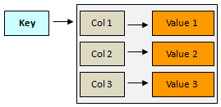

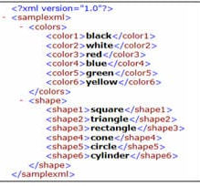
Categories of NoSQL databases
Graph database
XML databases
Key/Value
Column -oriented
Document-oriented

Slide 11
Basic NoSQL API
Basic API access:
Extract the value given a key get(key)
Create or update the value given its key put(key, value)
Remove the key and its associated value delete(key)
Invoke an operation to the value (given its key) which is a special data structure (e.g. List, Set, Map .... etc) execute(key, operation, parameters)
Not (well)supported:
Relations (foreign keys)
Joins
Aggregations
Notes:
-> http://horicky.blogspot.com/2009/11/nosql-patterns.html

Slide 12
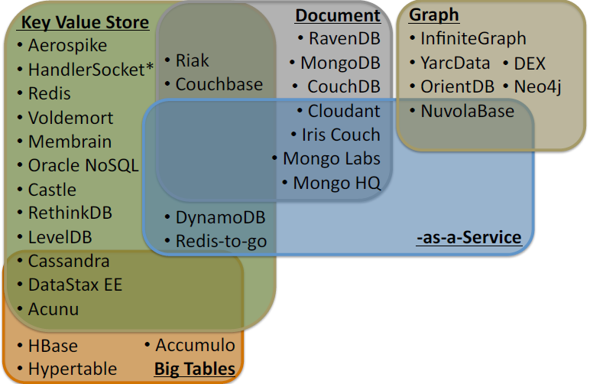
NoSQL family

Slide 13
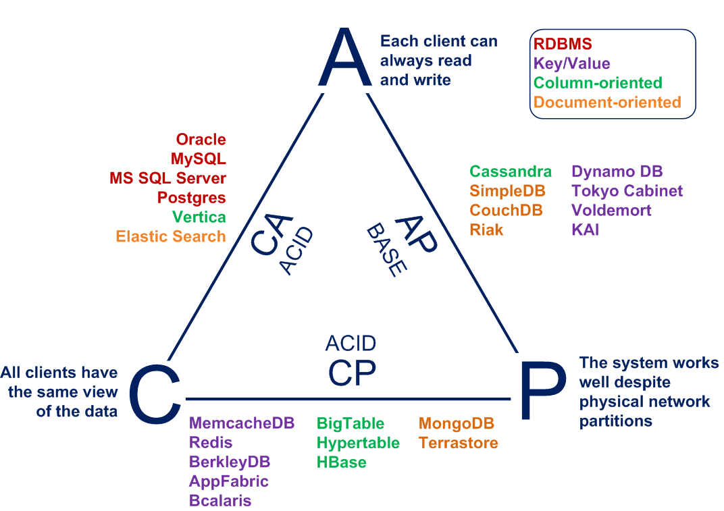
NoSQL databases: CAP implication

Slide 14


Map-Reduce Algorithm
Map-Reduce Example
Hadoop

Slide 15
MapReduce
MapReduce is a programming framework that allows to perform distributed and parallel processing on large data sets in a distributed environment
MapReduce consists of two distinct tasks: Map and Reduce
The reducer phase takes place after the mapper phase has been completed.
During the map job a block of data is read and processed to produce key-value pairs as intermediate outputs.
The output of a Mapper (key-value pairs) is input to the Reducer.
The reducer receives the key-value pair from multiple map jobs.
Then, the reducer aggregates those intermediate data tuples (intermediate key-value pair) into a smaller set of tuples or key-value pairs which is the final output.

Slide 16
MapReduce: Inputs and Outputs
The MapReduce framework operates exclusively on <key, value> pairs.
Input and Output types of a MapReduce job:
(input) <k1, v1> -> map -> <k2, v2>
<k2, v2> -> combine -> <k2, v2>
<k2, v2> -> reduce -> <k3, v3> (output)
Example: count the appearance of each word in a set of documents
function map(String name, String document):
// name: document name k1
// document: document contents v1
for each word w in document:
emit (w, 1) // <k2,v2>
function reduce(String word, Iterator partialCounts):
// word: a word k2
// partialCounts: a list of aggregated partial counts v2
sum = 0
for each pc in partialCounts:
sum += pc
emit (word, sum) // <k3,v3>
List <k2, v2> -> combine -> <k2, List(v2)>

Slide 17
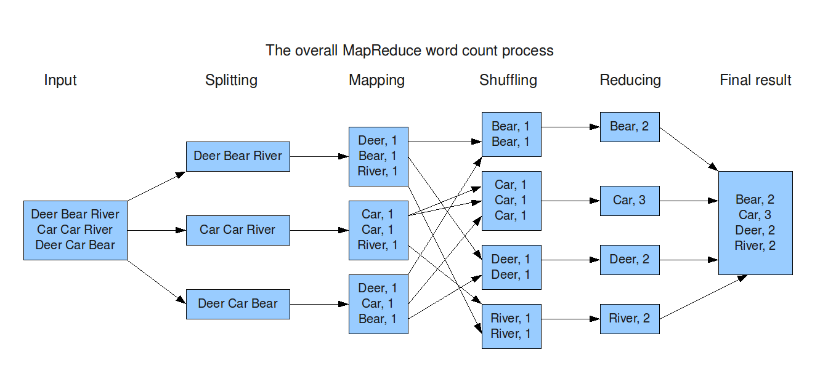
MapReduce: A word count example
<k1, v1>
List <k2, v2>
<k2, List(v2)>
<k3, v3>
List <k3, v3>
line1
doc1
line2
line3

Slide 18
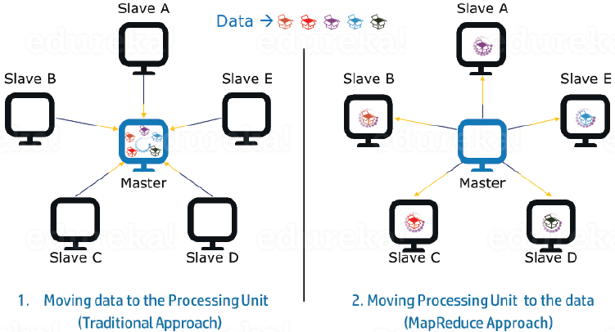
MapReduce: Advantages of MapReduce
Parallel Processing: a job is divided among multiple nodes and each node works with a part of the job simultaneously; As the data is processed by multiple machines instead of a single machine in parallel, the time taken to process the data gets reduced by a tremendous amount.
Data Locality: the data is distributed among multiple nodes where each node processes the part of the data residing on it; the processing unit (executable software code) is bringing to the data

Slide 19
Hadoop: Distributed Data Processing
Apache Hadoop is an open-source software framework for storage and large-scale processing of data-sets on clusters of commodity hardware.
Hadoop Distributed File System (HDFS) – a distributed file-system that stores data on commodity machines, providing very high aggregate bandwidth for batch processing.
Hadoop MapReduce – a programming model for large scale data processing.
Many others ...

Slide 20

Hadoop: Principles
Scale-Out rather than Scale-Up
Use “commodity” unreliable hardware
Bring code to data rather than data to code
Co-locate processors and storage
Provide fault-tolerance (failures are common)
Abstract complexity of distributed and concurrent applications

Slide 21
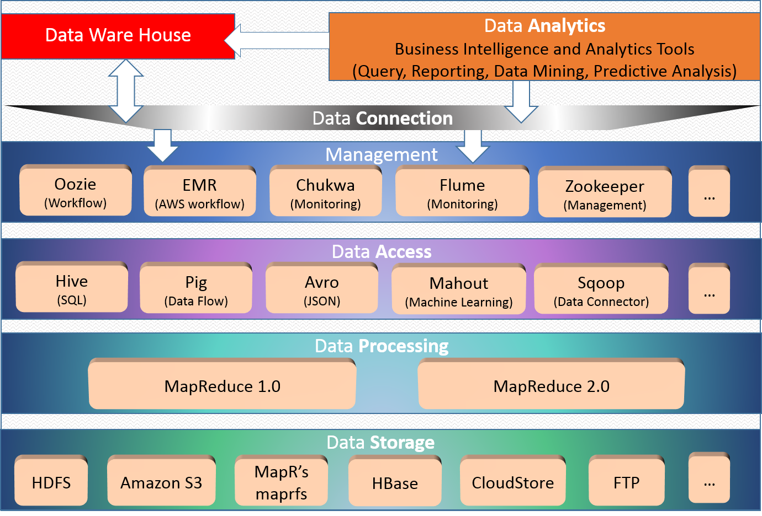
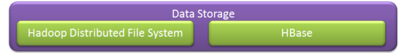
Hadoop: Stack
Data Analytic (Query, Reporting, Data Manning, Predictive Analytic)
Data Warehouse

Slide 22
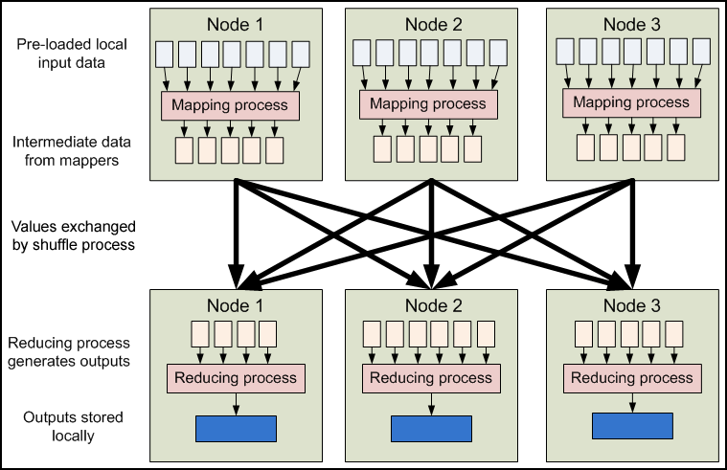
Hadoop: Distributed Data Processing

Slide 23
Cloud computing, cloud databases
Cloud computing
data intensive applications on hundreds of thousands of commodity servers and storage devices
basic features:
Pay-as-you-go
Elasticity on demand
Scaling out, data partitioning
Fault-tolerance
Automatic provisioning
Database-as-a-service (DBaaS)
Amazon RDS
Amazon SimpleDB
Amazon DynamoDB
Azure SQL Database
...

Slide 24
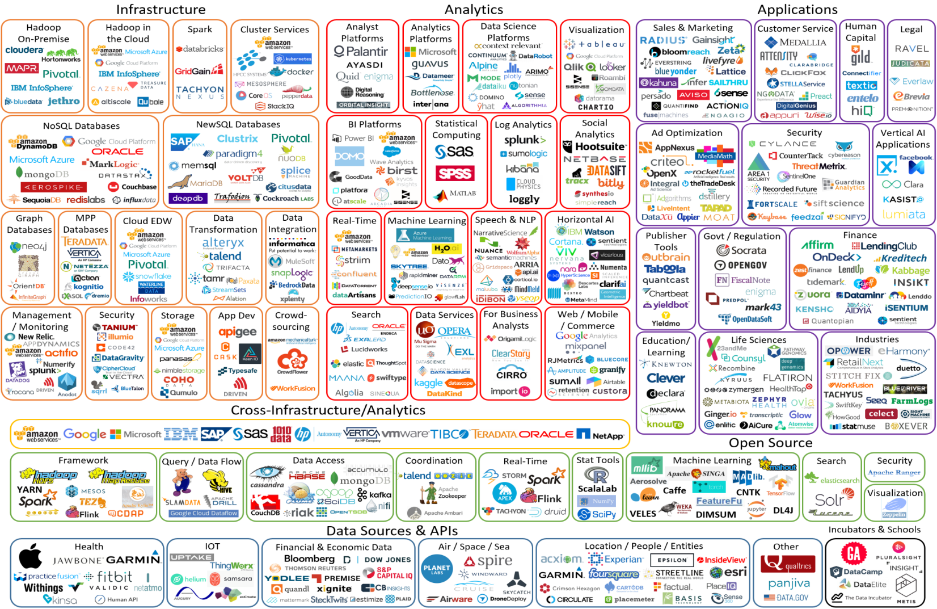
Big Data Landscape

